Slide 1
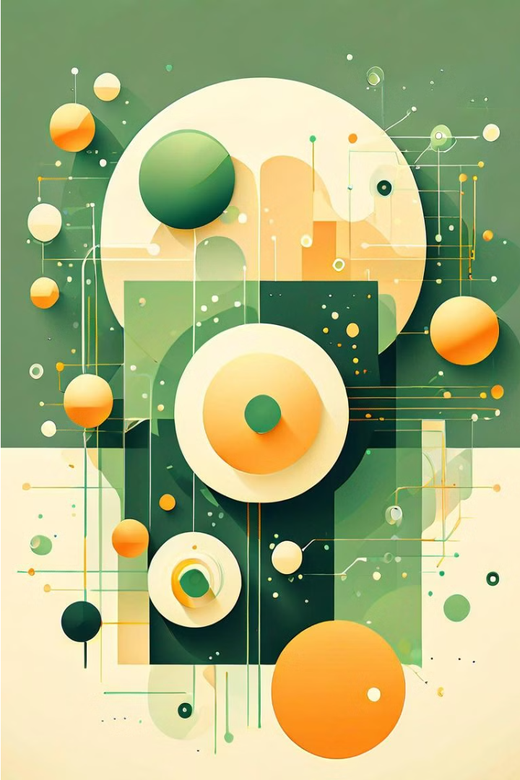


Introduction to Generative AI and GANs
Generative AI, particularly Generative Adversarial Networks (GANs), is a powerful technique that has revolutionized various fields, including natural language processing. GANs can generate new, realistic-looking text by learning patterns from existing data.
by Flemmy. J

Slide 2
Fundamentals of Generative Adversarial Networks (GANs)
Dual Network Architecture
Adversarial Training
GANs consist of two neural networks - a generator and a discriminator - that are trained in a competitive, adversarial manner to produce realistic synthetic data.
The generator tries to produce realistic outputs to fool the discriminator, while the discriminator aims to accurately distinguish between real and generated data.
Unsupervised Learning
Creativity and Imagination
GANs learn to generate new data without the need for labeled training examples, making them a powerful unsupervised learning technique.
By pitting the generator and discriminator against each other, GANs can learn to produce highly creative and imaginative outputs that go beyond simple data replication.

Slide 3
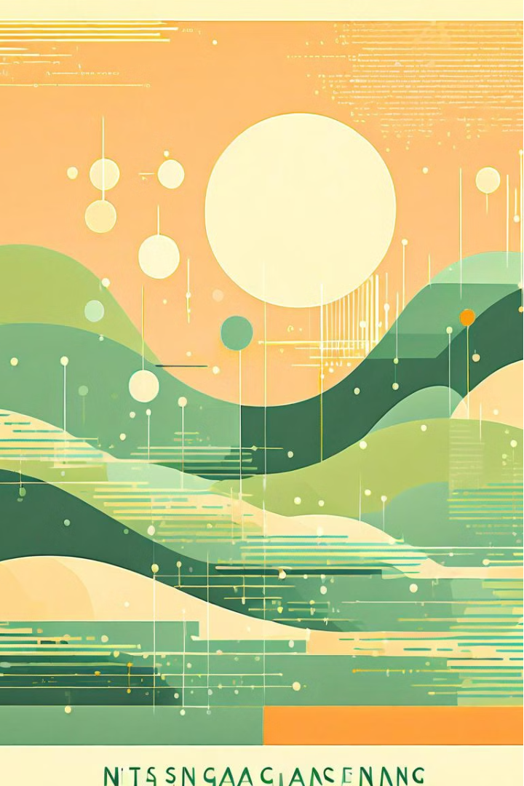
Applications of GANs in Natural Language Processing
Generating synthetic text that mimics the style and content of real-world data, such as news articles, social media posts, or creative writing.
Performing text style transfer, transforming the style of a given text to match a target writing style, such as formal or informal, while preserving the underlying meaning.
Enhancing text-based dialog systems by generating more natural and coherent responses, improving conversational abilities.

Slide 4
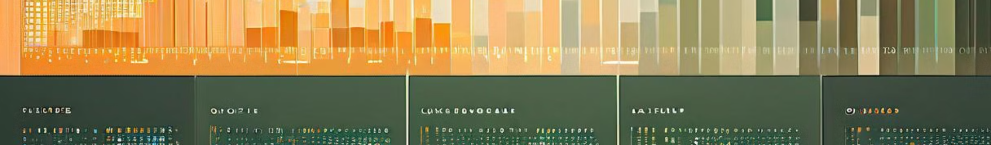
Text Generation using GANs
Conditional Text Generation
1
GANs can be used to generate text conditioned on specific attributes, like sentiment, topic, or style. This allows for more controlled and targeted text generation.
2
Diversity in Output
GAN-based text generation models can produce diverse and creative outputs, going beyond simple template-based generation to generate novel and unique text.
Improving Quality
3
Advancements in GAN architectures and training techniques have led to significant improvements in the quality, coherence, and fluency of generated text.

Slide 5

Techniques for Text Generation with GANs
GANs for text generation employ a two-part architecture - a generator and a discriminator. The generator learns to produce realistic-looking text, while the discriminator evaluates the quality of the generated text. Through this adversarial training, the generator progressively improves at generating authentic-looking text.
Key techniques include using recurrent neural networks, variational autoencoders, and reinforcement learning to enhance the generation capabilities of the GAN model. Techniques like beam search, top-k sampling, and nucleus sampling help control the diversity and quality of the generated text.

Slide 6
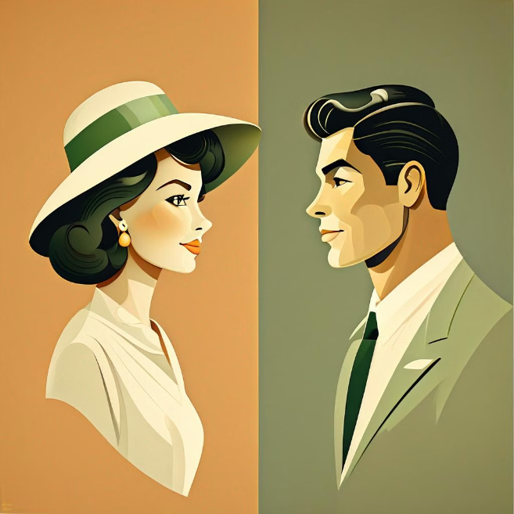
Style Transfer in Text using GANs
GANs have shown promise in transferring the style of one text to another, preserving the content while altering the linguistic attributes like tone, formality, and sentiment. This allows for personalized text generation, adapting content to different audiences or purposes.
Style transfer models can be trained on parallel datasets of text in different styles, enabling them to learn the underlying stylistic transformations. The generator component learns to modify the text while the discriminator ensures the generated output maintains the target style.

Slide 7
Challenges and Limitations of GAN-based Text Generation
1
Lack of Controllability
2
Unstable Training
GAN models used for text generation often struggle to provide fine-grained control over the generated output, making it difficult to steer the text towards desired attributes or qualities.
The adversarial training process of GANs can be notoriously unstable, leading to challenges in reliably training the models and producing consistent, high-quality text.
3
Semantic Incoherence
4
Preserving Grammatical Structure
GAN-generated text can sometimes lack coherence and logical flow, resulting in outputs that may not make sense or convey meaningful information.
Ensuring that GAN-generated text adheres to proper grammatical rules and conventions can be a significant challenge, especially for more complex language structures.

Slide 8
Ethical Considerations in Generative AI for Text
Bias and Fairness
Authenticity and Deception
Privacy and Security
Responsible Development
Generative AI models trained on large language datasets may perpetuate societal biases and produce discriminatory text outputs. Careful model design and data curation are crucial to ensuring fairness and inclusivity.
The ability of GANs to generate highly convincing text raises concerns about the potential for misuse, such as creating fake news or impersonating real people. Transparency and accountability are key to maintaining trust.
Generative AI systems that can produce personal or sensitive information raise privacy risks. Robust data protection protocols and user consent mechanisms are necessary to safeguard individual privacy.
Developers of generative text AI must consider the societal impact and potential for harm. Responsible development practices, including ethical review and impact assessments, can help mitigate risks.

Slide 9



Recent Advancements and Future Directions
Accelerated Research
Emerging Applications
Addressing Challenges
The rapid progress in deep learning and computational power has enabled researchers to explore more complex GAN architectures and techniques for text generation.
GANs are being explored for novel applications in areas like dialogue systems, summarization, and even creative writing, pushing the boundaries of language generation.
Researchers are working to overcome challenges like mode collapse, instability, and lack of control, to make GAN-based text generation more robust and reliable.

Slide 10
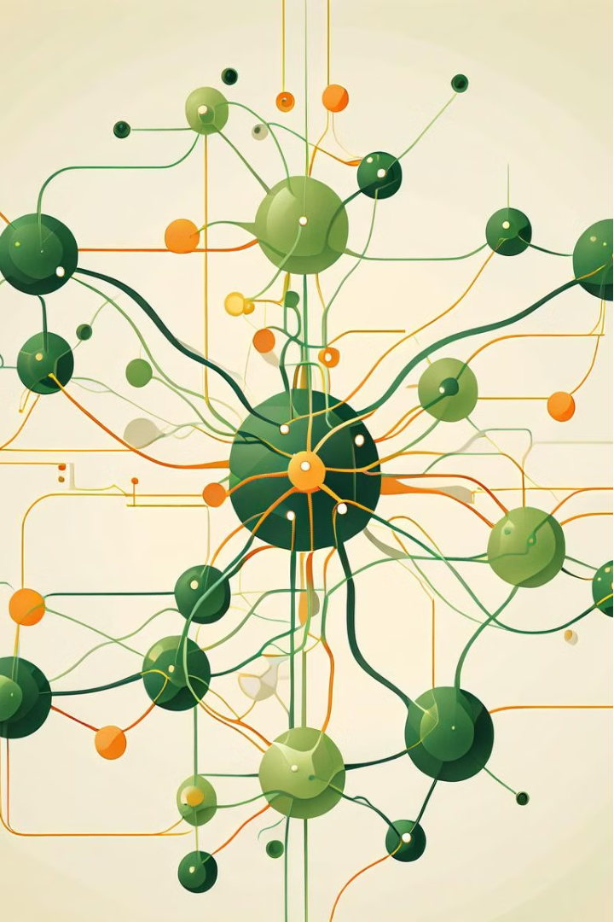
Conclusion and Key Takeaways
In conclusion, Generative Adversarial Networks (GANs) have emerged as a powerful tool in Natural Language Processing, revolutionizing text generation and style transfer. By leveraging the adversarial training process, GANs can produce highly realistic and diverse text, opening up new possibilities for creative writing, dialogue systems, and content personalization.
The key takeaways from this presentation include the fundamental principles of GANs, their wide-ranging applications in NLP, and the techniques used for generating high-quality text. While challenges around controllability, bias, and ethical considerations remain, the rapid advancements in this field promise even more exciting developments in the future.

